Slide 1
人工智慧與資訊安全
Pandas資料分析學習報告
學生:4060e051 陳有言
指導教授:曾龍

Slide 2
Agenda
1.資料科學與Pandas資料分析
2.pandas資料分析技術(1)
3.pandas資料分析技術(2)
4.Pandas數據分析例子

Slide 3
資料科學與Pandas資料分析

Slide 4
例子
import pandas as pd # 引用套件並縮寫為 pd
cars = [“BMW”, “BENZ”, “Toyota”, “Nissan”, “Lexus”]
select = pd.Series(cars) #Series是處理序列相關的資料
print(select)

Slide 5
執行結果
0 BMW
1 BENZ
2 Toyota
3 Nissan
4 Lexus
dtype: object

Slide 6
程式碼
import pandas as pd
cars = "BENZ"
select = pd.Series(cars, index = range(3)) #
print(select)

Slide 7
執行結果
0 BENZ 1 BENZ 2 BENZ dtype: object

Slide 8
程式碼
dict = {
"factory": "Taipei",
"sensor1": "1",
"sensor2": "2",
"sensor3": "3",
"sensor4": "4",
"sensor5": "5"
}
select = pd.Series(dict, index = dict.keys()) # 排序與原 dict 相同
print(select[0])
print("=====")
print(select['sensor1'])
print("=====")
print(select[[0, 2, 4]])
print("=====")
print(select[['factory', 'sensor1', 'sensor3']])

Slide 9
執行結果
Taipei
=====
1
=====
factory Taipei
sensor2 2
sensor4 4
dtype: object
=====
factory Taipei
sensor1 1
sensor3 3
dtype: object

Slide 10
程式碼
import pandas as pd # 引用套件並縮寫為 pd
groups = ["Movies", "Sports", "Coding", "Fishing", "Dancing", "cooking"]
num = [66, 8, 12, 10, 6, 58]
dict = {"groups": groups,
"num": num
}
select_df = pd.DataFrame(dict)
print(select_df) # 看看資料框的外觀

Slide 11
執行結果
groups num
0 Movies 66
1 Sports 8
2 Coding 12
3 Fishing 10
4 Dancing 6
5 cooking 58

Slide 12
程式碼
import pandas as pd
dict = {
"factory": "Taipei",
"sensor1": "1",
"sensor2": "2",
"sensor3": "3",
"sensor4": "4",
"sensor5": "5"
}
select = pd.Series(dict, index = dict.keys()) # 排序與原 dict 相同
print(select[:2])
print("=====")
print(select['sensor2':])

Slide 13
執行結果
factory Taipei
sensor1 1
dtype: object
=====
sensor2 2
sensor3 3
sensor4 4
sensor5 5
dtype: object
print(select[:2])
print(select['sensor2':])

Slide 14
程式碼
import pandas as pd # 引用套件並縮寫為 pd
groups = ["Movies", "Sports", "Coding", "Fishing", "Dancing", "cooking"]
num = [66, 8, 12, 10, 6, 58]
dict = {"groups": groups,
"num": num
}
select_df = pd.DataFrame(dict)
print(select_df) # 看看資料框的外觀

Slide 15
執行結果
groups num
0 Movies 66
1 Sports 8
2 Coding 12
3 Fishing 10
4 Dancing 6
5 cooking 58
將資料和名稱整理成二維資料集

Slide 16
程式碼
import pandas as pd
arr = groups = [["Movies", 50],["Sports", 10], ["Coding", 12], ["Fishing",12], ["Dancing",6], ["cooking",8]]
df = pd.DataFrame(arr, columns = ["name", "num"]) # 指定欄標籤名稱
print(df)

Slide 17
執行結果
name num
0 Movies 50
1 Sports 10
2 Coding 12
3 Fishing 12
4 Dancing 6
5 cooking 8
以array資料呈現

Slide 18
pandas資料分析技術(1)

Slide 19
程式碼
# Pandas 的 data frame 資料結構有一些方法或屬性
import pandas as pd
groups = ["Movies", "Sports", "Coding", "Fishing", "Dancing", "cooking"]
num = [50, 23, 20, 12, 6, 58]
dict = {"groups": groups,
"num": num
}
select_df = pd.DataFrame(dict)

Slide 20
程式碼
print(select_df.shape) # 回傳列數與欄數
print("---")
print(select_df.describe()) # 回傳描述性統計
print("---")
print(select_df.head(3)) # 回傳前三筆觀測值
print("---")
print(select_df.tail(3)) # 回傳後三筆觀測值
print("---")
print(select_df.columns) # 回傳欄位名稱
print("---")
print(select_df.index) # 回傳 index
print("---")
print(select_df.info) # 回傳資料內容

Slide 21
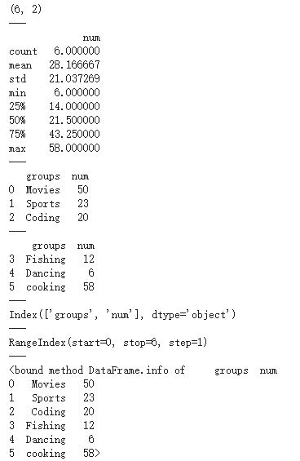
執行結果
以各個函數呈現
回傳列數與欄數
回傳描述性統計
回傳前三筆觀測值
回傳後三筆觀測值
回傳欄位名稱
回傳 index
回傳資料內容

Slide 22
程式碼
import pandas as pd # 引用套件並縮寫為 pd
groups = ["Movies", "Sports", "Coding", "Fishing", "Dancing", "cooking"]
num = [46, 8, 12, 12, 6, 58]
dict = {"groups": groups,
"num": num
}
select_df = pd.DataFrame(dict)
select_df.sort_index(axis = 0, ascending = True) # 透過索引值做排序，axis 可以指定第幾欄，ascending 用於設定升冪或降密

Slide 23
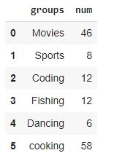
執行結果

Slide 24
程式碼
import pandas as pd # 引用套件並縮寫為 pd
groups = ["Movies", "Sports", "Coding", "Fishing", "Dancing", "cooking"]
num = [46, 8, 12, 12, 6, 58]
dict = {"groups": groups,
"num": num
}
select_df = pd.DataFrame(dict)
select_df.sort_values(by = 'num') #透過指定欄位的數值排序

Slide 25
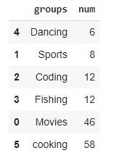
執行結果
依照num的大小排序

Slide 26
程式碼
data = {'state': ['Ohio', 'Ohio', 'Ohio', 'Nevada', 'Nevada', 'Nevada'],
'year': [2000, 2001, 2002, 2001, 2002, 2003],
'pop': [1.5, 1.7, 3.6, 2.4, 2.9, 3.2]}
frame = pd.DataFrame(data)
frame

Slide 27
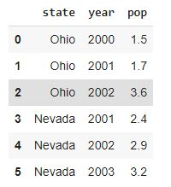
執行結果

Slide 28
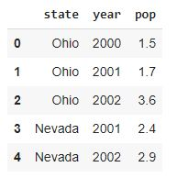
frame.head()
也可以自訂，只需要在括弧內加上要的數字

Slide 29
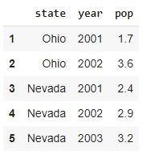
frame.tail()
要顯示最後五筆資料則可以使用.tail()，和head()一樣，可以在括號內加上要顯示幾筆資料

Slide 30
frame.info()
<class 'pandas.core.frame.DataFrame'>
RangeIndex: 6 entries, 0 to 5
Data columns (total 3 columns):
# Column Non-Null Count Dtype
--- ------ -------------- -----
0 state 6 non-null object
1 year 6 non-null int64
2 pop 6 non-null float64
dtypes: float64(1), int64(1), object(1)
memory usage: 272.0+ bytes
可以看到該檔案的資訊

Slide 31
frame['year'][0:4]
0 2000
1 2001
2 2002
3 2001
Name: year, dtype: int64
顯示year裡的資料，並只有第0筆選到小於4的資料

Slide 32
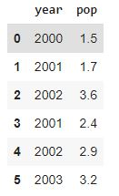
frame[['year','pop']]
顯示多項資料

Slide 33
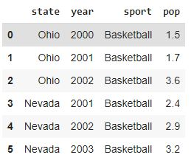
frame.insert(2,column="sport",value="Basketball") frame
新增一行資料

Slide 34
frame.columns
Index(['state', 'year', 'sport', 'pop'], dtype='object')
顯示行的索引

Slide 35
frame.to_numpy()
array([['Ohio', 2000, 'Basketball', 1.5],
['Ohio', 2001, 'Basketball', 1.7],
['Ohio', 2002, 'Basketball', 3.6],
['Nevada', 2001, 'Basketball', 2.4],
['Nevada', 2002, 'Basketball', 2.9],
['Nevada', 2003, 'Basketball', 3.2]], dtype=object)

Slide 36
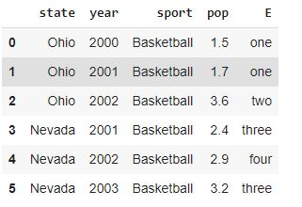
frame['E'] = ['one', 'one', 'two', 'three', 'four', 'three'] frame
新增資料

Slide 37
frame.iloc[3]
state Nevada
year 2001
sport Basketball
pop 2.4
E three
Name: 3, dtype: object

Slide 38

frame.iloc[3:5, 0:2]

Slide 39
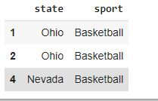
frame.iloc[[1, 2, 4], [0, 2]]

Slide 40

frame.iloc[1:3, :]

Slide 41
frame.iloc[1, 1]
2001

Slide 42

frame[frame['pop'] > 3]

Slide 43
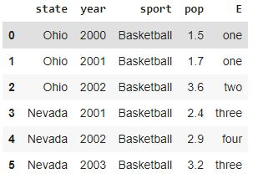
df2 = frame.copy() df2

Slide 44
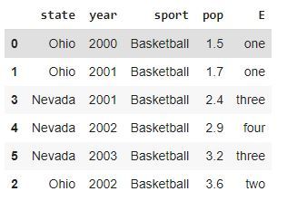
frame.sort_values(by="pop")

Slide 45
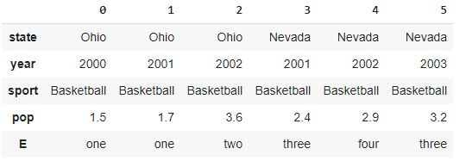
frame.T

Slide 46
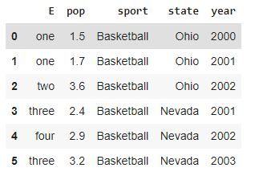
frame.sort_index(axis=1, ascending=True)

Slide 47
pandas資料分析技術(2)

Slide 48
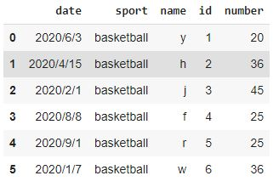
n = pd.read_csv("csv/1108.csv") n
讀取.csv檔並顯示

Slide 49
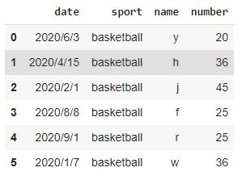
n.drop('id', inplace=True, axis=1)
刪除id那一行的資料

Slide 50
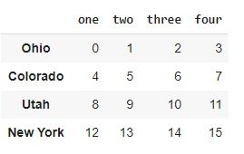
data = pd.DataFrame(np.arange(16).reshape(4, 4), index=['Ohio', 'Colorado', 'Utah', 'New York'], columns=['one', 'two', 'three', 'four']) data

Slide 51
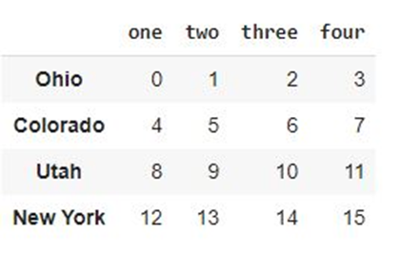
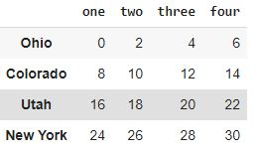
data + data1
將兩個表格的值相加
data
data1

Slide 52
ob = pd.Series([4.5, 7.2, -5.3, 3.6], index=['d', 'b', 'a', 'c']) ob
d 4.5
b 7.2
a -5.3
c 3.6
dtype: float64

Slide 53
ob2 = obj.reindex(['a', 'b', 'c', 'd', 'e']) ob2
a -5.3
b 7.2
c 3.6
d 4.5
e NaN
dtype: float64

Slide 54
ob = pd.Series(['bule', 'purple', 'yellow'], index=[0, 2, 4]) ob
0 bule
2 purple
4 yellow
dtype: object

Slide 55
ob.reindex(range(6), method='ffill')
0 bule
1 bule
2 purple
3 purple
4 yellow
5 yellow
dtype: object

Slide 56
obj = pd.Series(np.arange(5.), index=['a', 'b', 'c', 'd', 'e']) obj
a 0.0
b 1.0
c 2.0
d 3.0
e 4.0
dtype: float64

Slide 57
new_obj = obj.drop('c') new_obj
a 0.0
b 1.0
d 3.0
e 4.0
dtype: float64

Slide 58
obj.drop(['d', 'c'])
a 0.0
b 1.0
e 4.0
dtype: float64

Slide 59
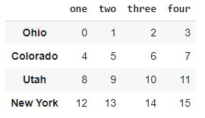
data = pd.DataFrame(np.arange(16).reshape(4, 4), index=['Ohio', 'Colorado', 'Utah', 'New York'], columns=['one', 'two', 'three', 'four']) data

Slide 60

data.drop(['Colorado', 'Ohio'])

Slide 61
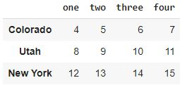
data.drop('Ohio', axis=0)

Slide 62
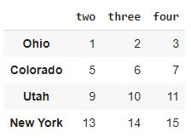
data.drop('one', axis=1)

Slide 63
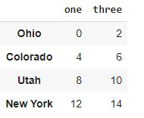
data.drop(['two', 'four'], axis='columns')

Slide 64
obj.drop('c', inplace=True) obj
a 0.0
b 1.0
d 3.0
e 4.0
dtype: float64

Slide 65
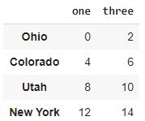
data.drop(['two', 'four'], axis='columns')

Slide 66
ser = pd.Series(np.arange(3.)) ser
0 0.0
1 1.0
2 2.0
dtype: float64

Slide 67
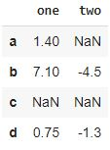
df = pd.DataFrame([[1.4, np.nan], [7.1, -4.5], [np.nan, np.nan], [0.75, -1.3]], index=['a', 'b', 'c', 'd'], columns=['one', 'two']) df

Slide 68
df.sum()
one 9.25
two -5.80
dtype: float64
計算每一行的和

Slide 69
df.sum(axis='columns')
a 1.40
b 2.60
c 0.00
d -0.55
dtype: float64
計算每一列的和

Slide 70
df.mean(axis='columns', skipna=False)
a NaN
b 1.300
c NaN
d -0.275
dtype: float64
把nan值的除外，而把每一列的值相加

Slide 71
df.idxmax()
one b
two d
dtype: object

Slide 72
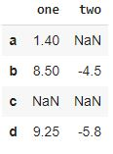
df.cumsum()
計算累加值

Slide 73
obj = pd.Series(['c', 'a', 'd', 'a', 'a', 'b', 'b', 'c', 'c']) uniques = obj.unique() uniques
array(['c', 'a', 'd', 'b'], dtype=object)
Unique()是挑出series裡的非重複值

Slide 74
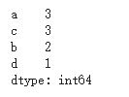
obj.value_counts()
Value_counts()能計算出字串各有多少，比如a有3個。

Slide 75
pd.value_counts(obj.values, sort=False)
c 3
b 2
d 1
a 3
dtype: int64

Slide 76
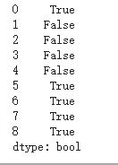
mask = obj.isin(['b', 'c']) mask

Slide 77
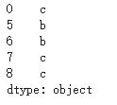
obj[mask]

Slide 78
to_match = pd.Series(['c', 'a', 'b', 'b', 'c', 'a']) unique_vals = pd.Series(['c', 'b', 'a']) pd.Index(unique_vals).get_indexer(to_match)
array([0, 2, 1, 1, 0, 2])
(先取出非重複值再建立索引)

Slide 79
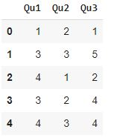
data = pd.DataFrame({'Qu1': [1, 3, 4, 3, 4], 'Qu2': [2, 3, 1, 2, 3], 'Qu3': [1, 5, 2, 4, 4]}) data

Slide 80
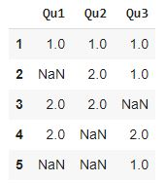
result = data.apply(pd.value_counts) result
會計算出值在每一行出現的次數
上一個程式碼

Slide 81
Pandas數據分析例子

Slide 82
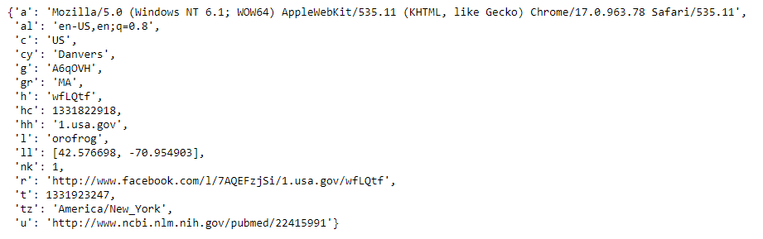
import json path = '../datasets/bitly_usagov/example.txt' records = [json.loads(line) for line in open(path)] records[0]
USA.gov數據集
(Json是一種輕量級的數據交換格式)
這方法叫列表推導式。
推導式是可以從一個資料序列構建另一個新的資料序列的結構體。

Slide 83

records[0]['tz']
只顯示設定好的資料

Slide 84
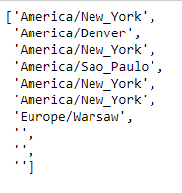
time_zones = [rec['tz'] for rec in records if 'tz' in rec] time_zones[:10]
顯示數據是集中在哪一個時區

Slide 85
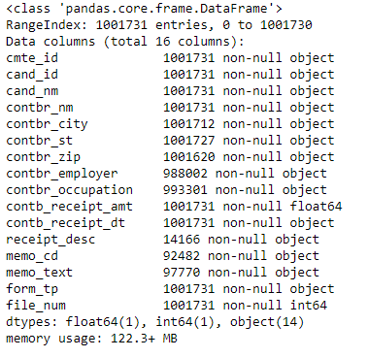
載入2020美國聯邦選舉委員會數據庫
pd.options.display.max_rows = 10
fec = pd.read_csv('../datasets/fec/P00000001-ALL.csv', low_memory=False)
# 不設定low_memory=False會顯示錯誤
fec.info()

Slide 86
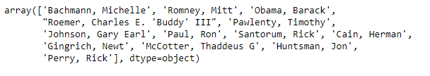
unique_cands = fec.cand_nm.unique() unique_cands
使用unique將候選人名單以array顯示出來

Slide 87
標記候選人是哪一個政黨
parties = {'Bachmann, Michelle': 'Republican',
'Cain, Herman': 'Republican',
'Gingrich, Newt': 'Republican',
'Huntsman, Jon': 'Republican',
'Johnson, Gary Earl': 'Republican',
'McCotter, Thaddeus G': 'Republican',
'Obama, Barack': 'Democrat',
'Paul, Ron': 'Republican',
'Pawlenty, Timothy': 'Republican',
'Perry, Rick': 'Republican',
"Roemer, Charles E. 'Buddy' III": 'Republican',
'Romney, Mitt': 'Republican',
'Santorum, Rick': 'Republican'}

Slide 88
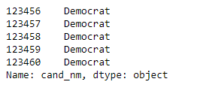
fec.cand_nm[123456:123461].map(parties)
用map方法，得到一組政黨數組

Slide 89

fec['party'] = fec.cand_nm.map(parties) fec['party'].value_counts()
使用value_counts()算出政黨總數

Slide 90

(fec.contb_receipt_amt > 0).value_counts()
將數據集中在有捐款的和退款的

Slide 91
參考
https://oranwind.org/python-pandas-ji-chu-jiao-xue/
https://nbviewer.jupyter.org/github/LearnXu/pydata-notebook/tree/master/Chapter-05/
https://nbviewer.jupyter.org/github/LearnXu/pydata-notebook/tree/master/Chapter-07/
https://nbviewer.jupyter.org/github/LearnXu/pydata-notebook/tree/master/Chapter-14/

